Slide 1

Dancing Hexapod
Aharon Sebton
Principles of Robotics

Slide 2
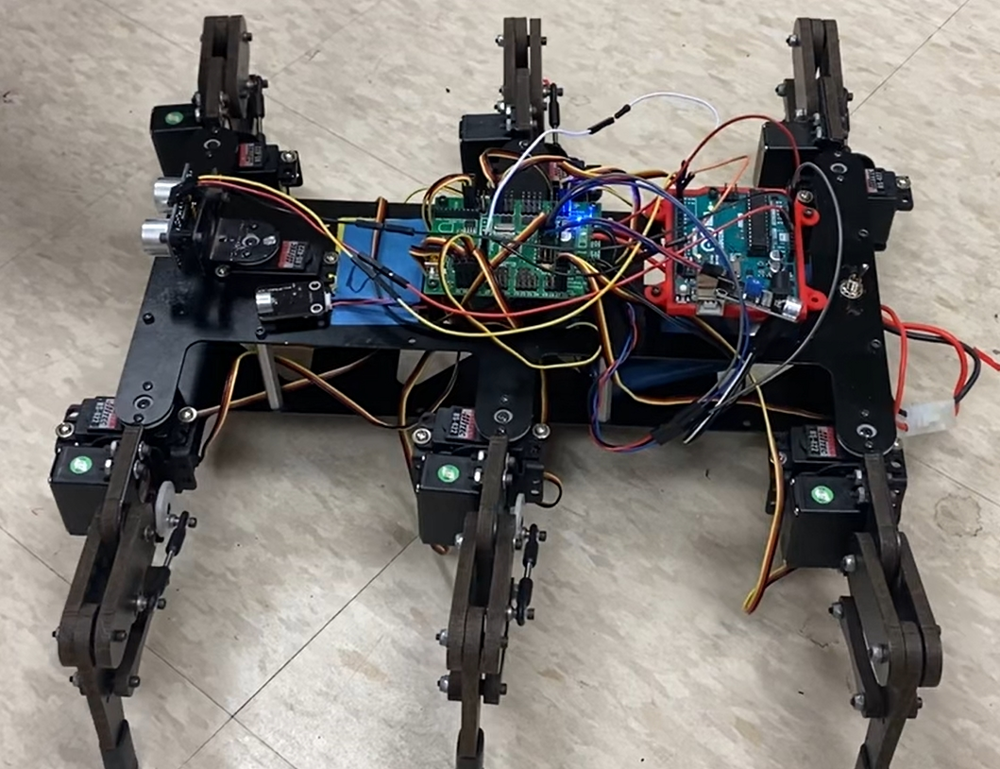
Goals
Accurately detect the BPM of the audio currently playing
Perform dance moves that are synchronized to the audio being played

Slide 3
BPM Detection
Two microphones used on front and back of hexapod
Powered by Lynxmotion SSC-32U
Data into Arduino Uno
Arduino used to process time-sampled audio
C++ script
Capture and store volume levels periodically
FFT Algorithm
Highest peak of frequency spectrum
Transform to frequency between 1-3 Hz (60-180 BPM)
Set delay between frame transformations
Hamming window

Slide 4
Troubleshooting
Problems
Powering more than one microphone at a time
Limited memory on Arduino Uno
Harmonics of true frequency present
Balancing total sample time and resolution
Motors have slow response time
Solutions
More than one 5V pin available on SSC-32
Implemented minimalist FFT algorithm and ran sampling/calculation function in semi-real time
Multiply/divide harmonic frequency by even integer to reach reasonable frequency (60-180 BPM or 1-3 Hz range)
Fs=16 Hz, 128 samples, 8 seconds/frame
No solution found

Slide 5
Future Expansions
Apply more filtering to improve functionality with real songs
Move towards the sound source before dancing
Find average volume level from each microphone
Move in direction of microphone with higher average until threshold is reached
Transfer project to Hexapod with 3 DoF per leg to allow more complex dance moves
Use Teensy 4.0 for more memory, processing power, and available libraries

Slide 6
Questions
How did I translate a reasonable BPM range to a reasonable frequency range?
What design factors needed to be balanced to determine an accurate BPM estimate?

Slide 7
